Slide 1
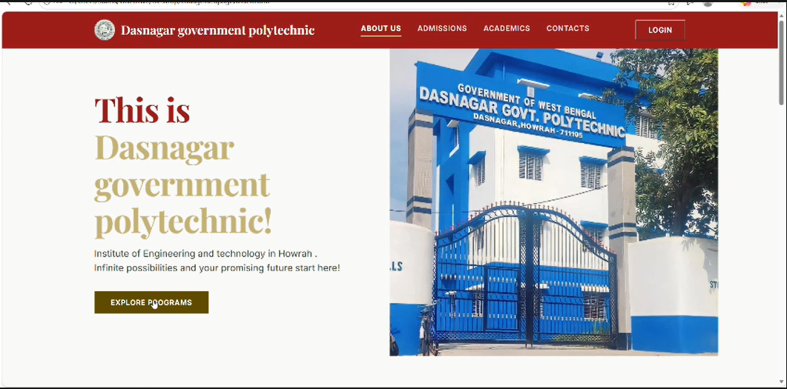
About Our College — Dasnagar Govt. Polytechnic

Slide 2
Acknowledgement
I express my sincere gratitude to MS PUSPITA MANNA and SHRI ACHINTYA GOPAL MONDAL of the Department of Information Technology and Engineering, DASNAGAR GOVT. POLYTECHNIC, for extending their valuable time to help me take up this problem as a project.
This presentation is based on the project “Evaluation of Academic Performance of Students,” carried out by Soumacharyya Paul, Debargho Pramanik, Kaustab Jana, Tuhin Sadhukhan, Sukanya Maji, Mahi Gupta, Piyali Majhi and Salma Khatun, students of the Diploma 4th Semester 2025-2026 batch, Department of Information Technology and Engineering, Dasnagar Govt. Polytechnic.

Slide 3
Index Page
01
Problem Statement
02
Objective
03
Technology Used
04
Project Work Flow
05
Output Screenshots

Slide 4
Problem Statement
Educational institutions deal with a large amount of student and teacher information every year, which is mostly maintained manually in registers or scattered across separate files. This makes it difficult to keep track of newly admitted students, organize their records properly, and retrieve the required information quickly whenever needed.
There is, therefore, a genuine need for a system where the details of both students and teachers can be stored together in an organized manner, allowing the institution to manage this information in its own way and access it easily, without depending on scattered paper records.
The “Evaluation of Academic Performance of Students” project has been undertaken with this very purpose in mind — to build a simple and organized platform that keeps student and teacher information in one place, so that the records of admitted students can be maintained, updated, and accessed conveniently whenever required.

Slide 5
Objective
The main goal of EduEval Portal is to digitize and simplify the academic result management process for polytechnic institutions.
Build a secure, role-based login system for Teachers and Students.
Allow teachers to register students, publish results, and edit academic data from a single dashboard.
Allow students to log in using their Registration ID, view subject-wise marks, CGPA, and result status.
Implement a PDF report download feature so students can save or print their official academic result.
Provide a live in-portal chat feature for real-time communication between teachers and students.
Ensure data integrity with server-side validation, session management, and parameterized SQL queries.

Slide 6
Technology Used
PHP
Server-side language used for handling login, session management, routing, and all database operations via PDO.
MySQL
Relational database that stores users, student profiles, subject marks, result data, and chat messages.
HTML / CSS
Markup and styling for all pages — responsive layout, tab-based login UI, result card design using Flexbox.
Local web server stack used for development. Handles HTTP requests, PHP processing, and serves the application.
Apache / XAMPP

Slide 7
Project Work Flow
System Flow
Role-Based Actions
↓
User opens index.php (Login Page)
Teacher Can:
• Register / Edit / Delete student accounts
↓
Selects role: Teacher or Student
• Publish result by entering subject marks
↓
Enters credentials → Server validates via PDO
• Edit existing results and recalculate CGPA
↓
Session is created with role & user_id
• View all students on Manage Results dashboard
• Send messages in Live Chat
↓
Redirected to dashboard.php
Student Can:
↓
Role-based UI rendered (Teacher / Student)
• Log in using Registration ID and password
↓
All API calls pass through api.php with session check
• View subject-wise marks and CGPA
↩
• Download official academic result as PDF
User clicks Logout → session_destroy() → redirect to login
• Send messages in Live Chat

Slide 8
Output Screenshots — Login Page
🎓 Student
📚 Teacher
🎓 Student
📚 Teacher
Student Login
Teacher Login
Welcome back! Please enter your details.
Welcome back! Please enter your details.
Registration No
Teacher ID
D232410652
admin
Password
Password
••••••••••
••••••••••
Log In
Log In
Don't have an account? Register Now
Fig 1: Student Login
Fig 2: Teacher Login

Slide 9
Output Screenshots — Teacher Dashboard
EduEval
Portal
Welcome, Main Admin TEACHER
Add New Result
Class Records
Manage Results
Search Registration ID
Reg ID
Student
Dept
CGPA
Status
Action
Student Details
Search
E.G. REG101
D232410696
Soumacharyya P.
ITE
7.26
PASS
Edit Del
Log Out
D232410955
Mahi Gupta
ITE
5.96
PASS
Edit Del
D232410652
Debargha P.
ITE
6.22
PASS
Edit Del
💬 Live Support
Fig 3: Teacher Dashboard — Manage Results

Slide 10
Output Screenshots — Student Result Card
EduEval
Portal
Welcome, Soumacharyya Paul STUDENT
Your Academic Result
My Result
OFFICIAL ACADEMIC REPORT
Log Out
Soumacharyya Paul
Dept: ITE
Year: 2 | Sem: 4
Registration ID: D232410696
Subject
Marks
Subject
Marks
Operating Systems
99
Minor Project
70
DBMS
76
OS Lab
59
Comp. Networks
59
DBMS Lab
50
Java
69
CN Lab
77
Soft. Engineering
78
Java Lab
89
CGPA: 7.26
PASS
Fig 4: Student Result Card with Subject-wise Marks and CGPA

